Slide 1
Design Thinking
Dustin Fishel
Bus 550
5/13/13

Slide 2
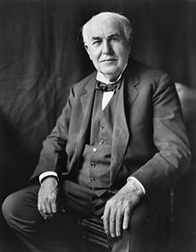
Thomas Edison
Born February 11, 1847
Inventor of:
  Phonograph
  Kinetophone
  Motion pictures
  Light bulb
    Useless without electricity in every house
  Electricity in every house
http://en.wikipedia.org/wiki/Thomas_edison

Slide 3
What is design thinking?
A Method of focusing innovation on people and designing based on:
  What people need and want
  What people like or dislike
    In regards to production, packaging, marketing, retailing, support, or all of them
A skill that allows a designer to align what people want with what can be done, and produce a viable business strategy that creates customer value and market opportunity

Slide 4
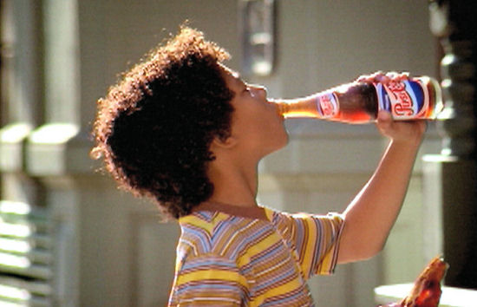

Examples of design
Historically a designer would come along and make an already established idea seem more desirable:
  Ad campaign
  Pretty packaging
http://www.publicgym.com/soda-the-fat-peoples-nectar-of-the-gods/
http://www.iheartkroger.com

Slide 5
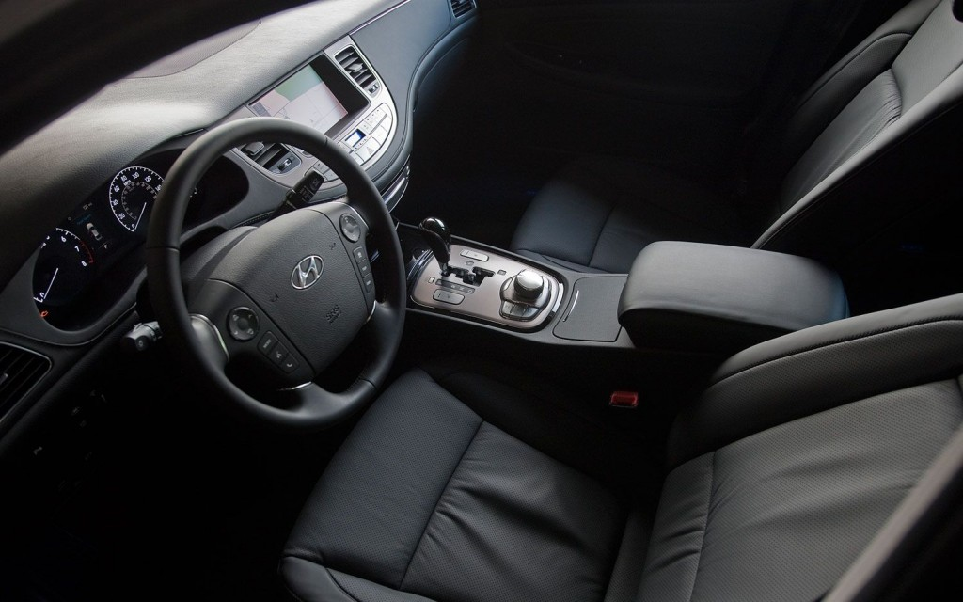
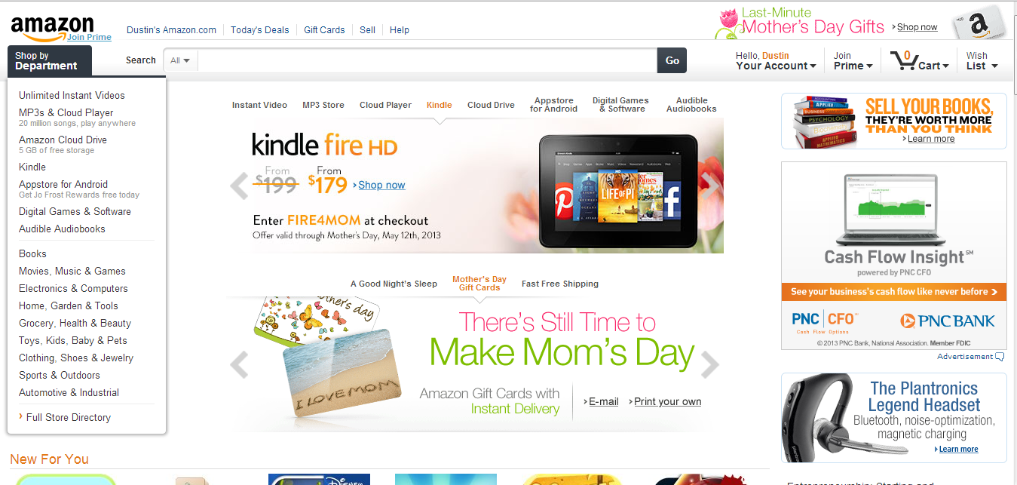
Examples of design
Now designers are being asked to change what is being produced to better meet the needs of consumers
  Tangible goods
  Processes
    Interfaces
    Entertainments
    Services
wot.motortrend.com

Slide 6
Spaces of design thinking
Inspiration
Implementation
Ideation

Slide 7
Inspiration
Identify a problem
  When something isn’t perfect, there is opportunity for design thinking
  Example: Kaiser permanente had issues with information flow between nurses during shift change
    Problem: patient care wasn’t perfect; nurses had no system for cataloging patient information, inefficient, and incomplete.

Slide 8
Ideation
Prototyping
  Does not have to be complex or expensive
    `Must be physical
      Intangibles can be taped
      Visualizing helps review
    True prototypes beg for improvement
      A “finished” prototype isn’t necessarily the best prototype
  Used to identify strengths and weaknesses of an idea and direct the next prototype in the best possible direction
  Test, re-prototype, test, re-prototype, test, re-prototype…

Slide 9
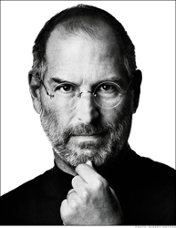
Implementation
Putting your best prototype into practice
    Control
    Compare
    Evaluate
www.forbes.com

Slide 10
Design thinking in action
Shimano – manufacturer of bicycle parts
  Inspiration
    Slowing growth in American markets
      Discuss with consumers – human-centered exploration
      Discovered growing intimidation of complex marketplace
  Ideation
    Developed “coasting”
      Simplistic bikes
      Marketing strategy that welcomed novice bikers
      Branding
  Implementation
    3 manufactures on board
    Retailers on board
    Website developed to get the word out

Slide 11
Design thinking in action
Aravind – Indian eye care system
  Inspiration
    Poverty and remoteness of clientele
      Discuss with consumers – human-centered exploration
      Classical options too expensive
  Ideation
    Develop new options
      Manufacture own parts
      Reduce cost to consumer from $200 to $4
      Bus patients to centers
  Implementation
    2.3 million patients seen in under a year
    270,000 surgeries performed
    “… translate existing evidence and knowledge into effective action” – www.aravind.org

Slide 12
Conclussion
Many problems in the world of business
  Technology shifts
  Shifting demographics
  Market shifts
Design thinking develops solutions
  Innovate
  Human-centered ideas
  Inspire

Slide 13
Question
Which of these is NOT one of the spaces of design thinking?
  Ideation
  Inspiration
  Interpretation
  Implementation

Slide 14
IDEO
Design thinking as a product itself

Slide 15
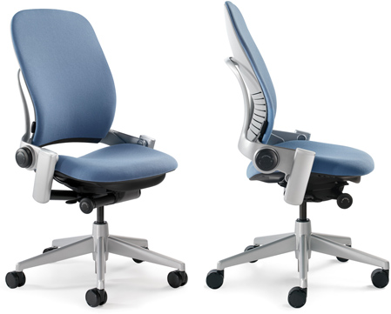
IDEO
Founded in 1991
  Product of merger between design firms:
    David Kelley Design
    ID Two
    Matrix Product Design
  Centered in Palo Alto
  Responsible for:
    Apples first mouse
    Palm V
www.thehumansolution.com

Slide 16
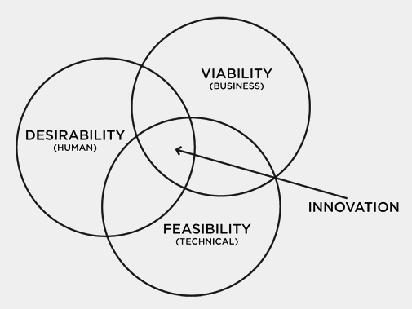
Design principle
Phases:
  0) Understand/observe
  Visualize/Realize
  Evaluating/Refining
  Implement (detailed engineering)
  Implement (manufacturing liason)

Slide 17
Phase 0: Understand/Observe
Study current market
  Current users
    Likes
    Dislikes
  Current techniques
  History
  Cost structure
Understand how things are
  Create feasibility record
  Other creative firms avoid this process

Slide 18
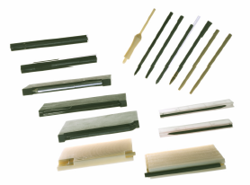

Phase 1: Visualize/Realize
Begin creating prototypes for potential solutions
  Rough
  Rapid
  Right
Constant contact with client
Full context of product use
  Storyboarding of characters using potential idea
  Brainstorming
    Focused
    Encourage wild ideas
    No judgement
    Build on others ideas
    Go for quantity

Slide 19
Phase 2: Evaluating/Refining
Begin turning rough prototypes of foam into functional prototypes
  Shift from human factors/needs to engineering
  Resolve technical issues
Concurrent engineering
  Engineer functionality
  Design aesthetically pleasing product

Slide 20
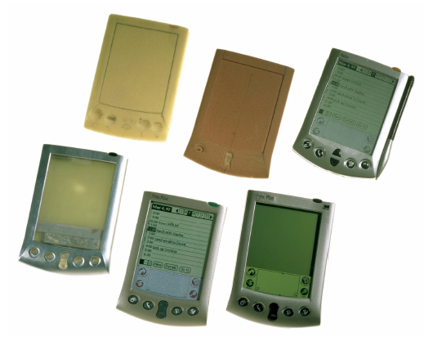
Phase 3: Implement (detailed engineering)
Verify the final product works
  Successfully does what you set out to do
  Meets regulations
  Stress test
Manufacturing protocols

Slide 21
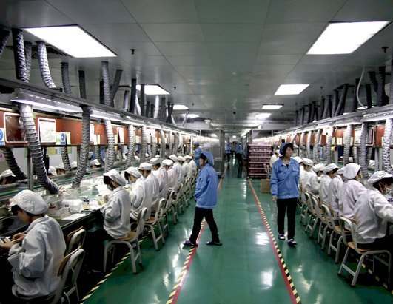
Phase 4: Implement (manufacturing liasison)
Move product from shop floor to client’s manufacturing facility
  Supervise production tooling
  Regulatory approvals
jailbreakstory.com

Slide 22
Results
This process has made IDEO one of the top 25 innovative companies
Winner of 38 Red Dot awards
more International Design Excellence Awards than any other design firm

Slide 23
Question
These are all part off the design process EXCEPT?
  Prototyping
  storyboarding
  Study current market
  Strict deadlines

Slide 24
Thank You!

